Slide 1
AN INTRODUCTION TO DATABASE PROGRAMMING
Chapter - 16

Slide 2
AN INTRODUCTION TO CLIENT/SERVER SYSTEMS
The three hardware components of a client/server system
The clients are the PCs, Macintoshes, or workstations of the system.
The server is a computer that stores the files and databases of the system and provides services to the clients. When it stores databases, it's often referred to as a database server.
The network consists of the cabling, communication lines, and other components that connect the clients and the servers of the system.

Slide 4
Client/server system implementations
Client/server system implementations in a simple client/server system like the one shown in the previous slide, the server is typically a high - powered PC that communicates with the clients over a local area network (LAN)
The server can also be a midrange system, like an IBM Power System or a Unix system, or it can be a mainframe system. Then, special hardware and software components are required to make it possible for the clients to communicate with the midrange and mainframe systems.
A client/server system can also consist of one or more PC-based systems, one or more midrange systems, and a mainframe system in dispersed geographical locations. This type of system is commonly referred to as an enterprise system.

Slide 5
THE SOFTWARE COMPONENTS OF A CLIENT/SERVER SYSTEM
Server software
To manage the network, the server runs a network operating system such as Windows Server .
To store and manage the databases of the client/server system, each server requires a database management system (DBMS) such as Microsoft SQL Server.
The processing that's done by the DBMS is typically referred to as back-end processing, and the database server is referred to as the back end.

Slide 7
THE SOFTWARE COMPONENTS OF A CLIENT/SERVER SYSTEM
Client software
The application software does the work that the user wants to do. This type of software can be purchased or developed.
The data access API (application programming interface) provides the interface between the application and the DBMS.
The data access API that we use is ADO.NET 4.5, which is a part of Microsoft's .NET Framework. The processing that's done by the client software is typically referred to as front-end processing, and the client is typically referred to as the front end.

Slide 8
THE SOFTWARE COMPONENTS OF A CLIENT/SERVER SYSTEM
The SQL interface
The application software communicates with the DBMS by sending SQL queries through the data access API.
When the DBMS receives a query, it provides a service like returning the requested data (the query results) to the client.
SQL, which stands for Structured Query Language, is the standard language for working with a relational database.

Slide 9
Client/server versus file-handling systems
In a client/server system, the processing done by an application is typically divided between the client and the server.
In a file-handling system, all of the processing is done on the clients. Although the clients may access data that's stored in files on the server, none of the processing is done by the server. As a result, a file-handling system isn't a client/server system.

Slide 10
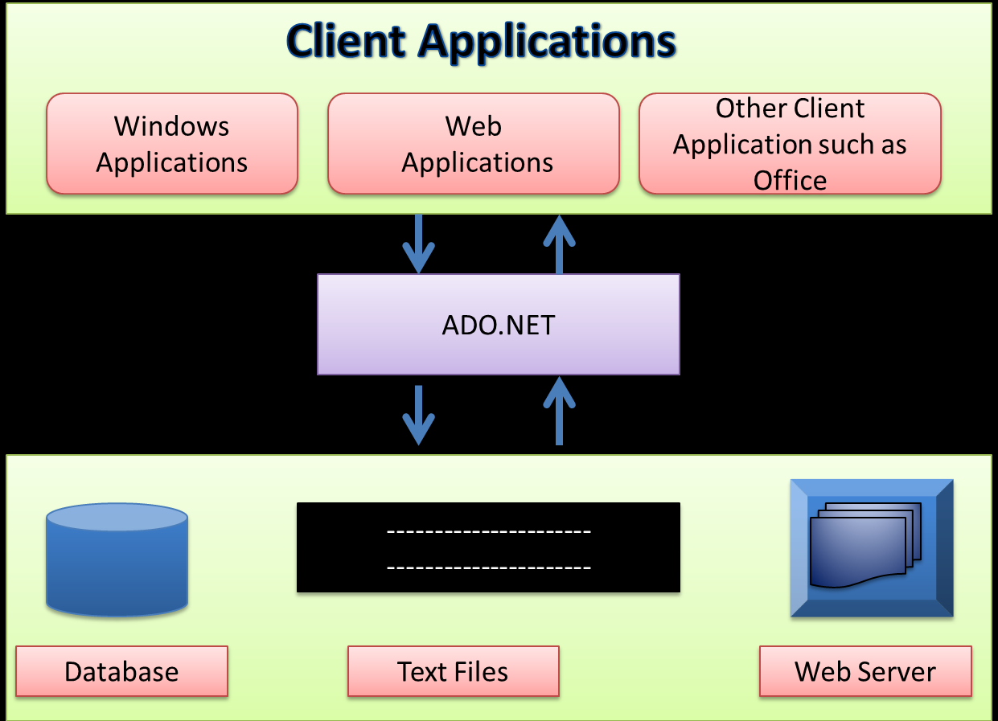
What is ADO.NET

Slide 11
AN INTRODUCTION TO ADO.NET
ADO.NET (ActiveX Data Objects .NET) is the primary data access API for the .NET Framework.
It provides the classes that you use as you develop database applications with C# as well as other .NET languages.
These classes can be divided into two categories:
the .NET data providers, which provide the classes that you use to access the data in a database, and
datasets, which provide the classes that you use to store and work with data in your applications.

Slide 12
The .NET data providers
A .NET data provider is a set of classes that enable you to access data that's managed by a particular database server.
All .NET data providers must include core classes for creating the four types of objects listed in the table in the next slide

Slide 14
The .NET data providers
The next slide lists the three data providers that come with the .NET Framework.
The SQL Server data provider is designed to provide efficient access to a Microsoft SQL Server database.
The OLE DB(Object Linking and Embedding DataBase) data provider is a generic data provider that can access any database that supports the industry standard OLE DB interface. Although you can use the OLE DB data provider to access a SQL Server database, you shouldn't do that unless you plan on migrating the data to another database since the SQL Server data provider is optimized for accessing SQL Server data.

Slide 16
The .NET data providers
The ODBC(Open Database Connectivity) provider lets you access any database that can work with ODBC, another industry standard database interface.
Note: .NET framework includes a data provider for Oracle, but it has been deprecated.

Slide 17
The .NET data providers
The next slide lists the names of the classes you use to create objects using the SQL Server, OLE DB, or ODBC providers.
Notice that these classes use prefixes ("Sql," "0leDb," "Odbc," ) to indicate which provider each class belongs to.

Slide 19
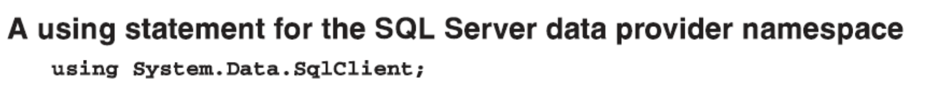
The .NET data providers
When you develop a C# application that uses ADO.NET, you'll want to add a using statement for the namespace that contains the data provider classes at the beginning of each source file that uses those classes.
That way, you won't have to qualify the references to these classes.

Slide 20
How a dataset is organized
A dataset object consists of a hierarchy of one or more data table and data relation objects.
A data table object consists of one or more data column objects and one or more data row objects.
The data column objects define the data in each column of the table, including its name, data type, and so on, and the data row objects contain the data for each row in the table.

Slide 22
How a dataset is organized
A data table can also contain one or more constraint objects that are used to maintain the integrity of the data in the table.
A unique key constraint ensures that the values in a column, such as the primary key column, are unique.
And a foreign key constraint determines how the rows in one table are affected when corresponding rows in a related table are updated or deleted.

Slide 23
How a dataset is organized
The data relation objects define how the tables in the dataset are related.
All of the objects in a dataset are stored in collections. For example, the data table objects are stored in a data table collection, and the data row objects are stored in a data row collection.

Slide 24
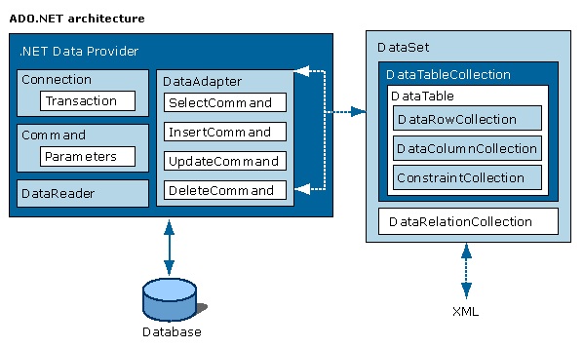

Slide 25
How the basic ADO.NET components work
When you use the .NET data provider objects to retrieve data from a database, you can store the data in an object called a dataset.
A dataset contains one or more data tables that store the data from the database.
Then, the application can retrieve and work with the data in the data tables, and it can Insert, update, and delete rows in the data tables.
To retrieve data from a database and store it in a data table, a data adapter object issues a Select statement that's stored in a command object.

Slide 26
How the basic ADO.NET components work
Next, the command object uses a connection object to connect to the database and retrieve the data.
Then, the data is passed back to the data adapter, which stores the data in a table within the dataset.
To update the data in a database based on the data in a data table, the data adapter object issues an Insert, Update, or Delete statement that's stored in a command object.
Then, the command object uses a connection to connect to the database and update the data.

Slide 28
How the basic ADO.NET components work
The data provider remains connected to the database only long enough to retrieve or update the specified data.
Then, it disconnects from the database and the application works with the data via the dataset object.
This is referred to as a disconnected data architecture.
The disconnected data architecture offers improved system performance due to the use of fewer system resources for maintaining connections.

Slide 29
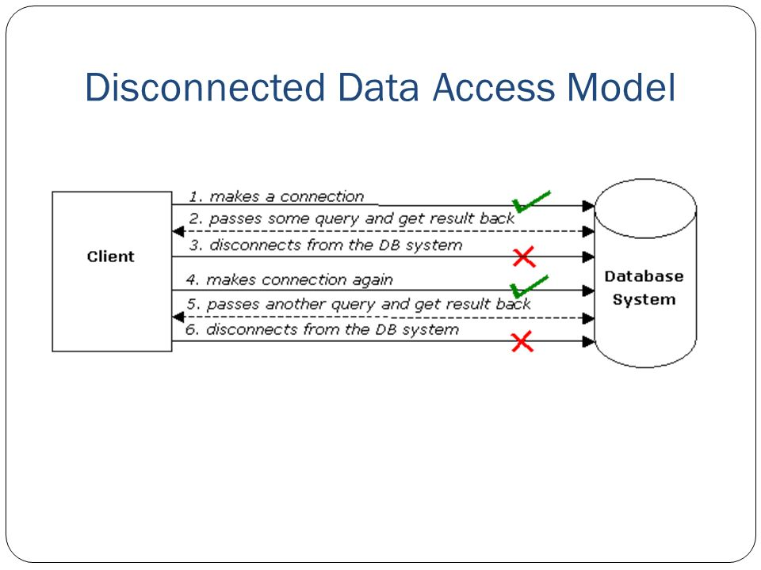

Slide 30
How to work with data without using a data adapter
Instead of using a data adapter to execute commands to retrieve, insert, update, and delete data from a database, you can execute those commands directly.
To retrieve data from a database, you execute a command object that contains a Select statement.
Then, the command object uses a connection to connect to the database and retrieve the data. You can then read the results one row at a time using a data reader object.

Slide 31
How to work with data without using a data adapter
To insert, update, or delete data in a database, you execute a command object that contains an Insert, Update, or Delete statement.
Then, the command object uses a connection to connect to the database and update the data.
You can then check the value that's returned to determine if the operation was successful.
If you use this technique in an application that maintains the data in a database, you typically work with a single row at a time. Because of that, the chance of a concurrency error is reduced. That way, there’s less chance that two users will retrieve and update the same row at the same time.

Slide 33
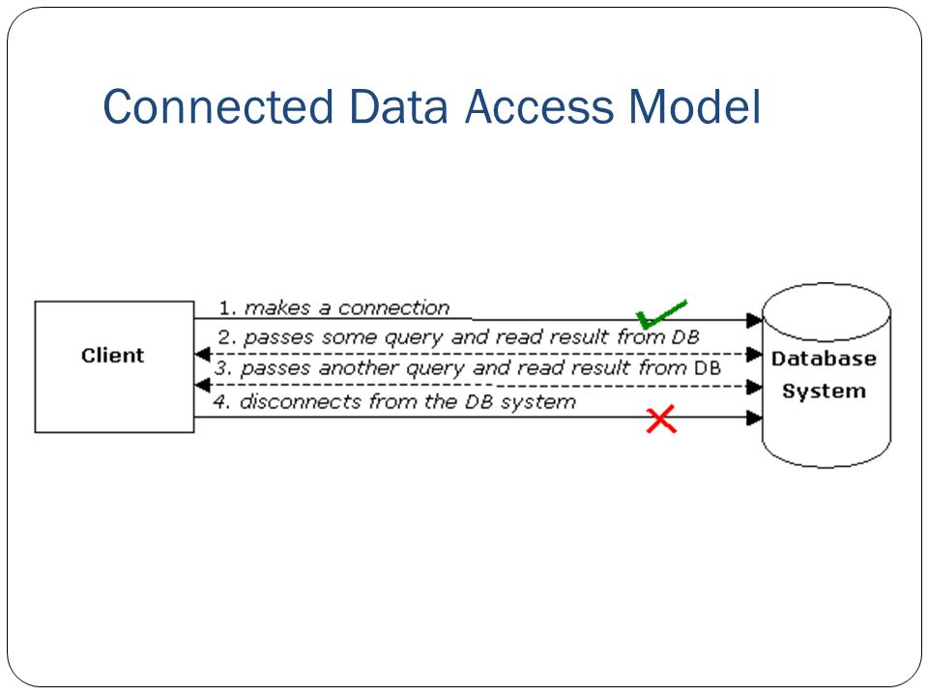

Slide 34
Two ways to create ADO.NET objects
You can create the ADO.NET object from a DataSource listed in the the Data Sources window.
Then, you can drag the data source onto the form to automatically generate a table adapter object and a dataset.
To create ADO .NET objects in code, you write a declaration that identifies the class each object is created from.

